Slide 1
Analyzing movie ratings according to their Genres
Aymen Soussi

Slide 2
Dataset details:
Data Source: IMDB Movie Dataset
Location: https://grouplens.org/datasets/movielens/
Filename: ml-20m.zip

Slide 3
Motivation
In this project, I would like to explore distributions of ratings within generes and analyze what type of generes are highly rated or low rated compared to others. As I am very much interested in Documentary movies, I would like to compare Documentary movies with other generes. This analysis could be helpful to movie producers.

Slide 4
Research Question:
Do Documentary movies tend to be rated more highly than other movie genres?

Slide 5
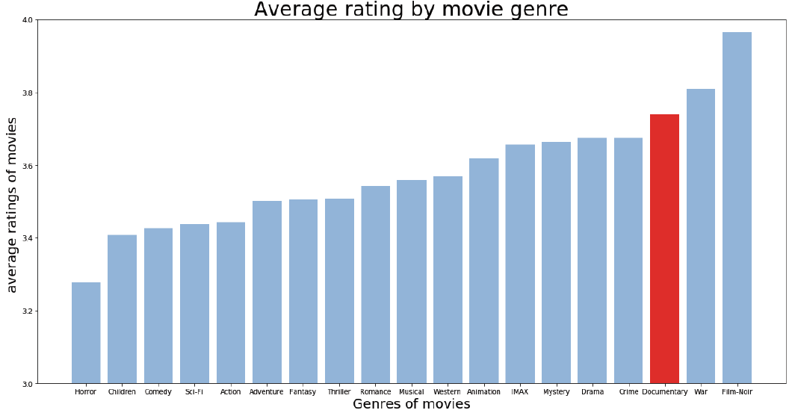
This plot represent the average rating by movie genre ascending order

Slide 6
Findings
This bar plot figure show that:
On average, Film-Noir genre has best average of rating.
On average, Horror genre movies have least rating.
On average, Documentary genre is in 17thposition.
Though, average ratings will be affected by the number of movies in the genres.

Slide 7
Conclusion
To conclude:
Comparison of the ratings by genres showed what type of genres are highly rated across genres and within genres.
Documentary movie are haily rated comparing to others movies genres, it’s ranked as the third most highest rating movie genre

Slide 8
Acknowledgements
I didn’t yet got feedback on my work from no one.

Slide 9
References
I did all the work by my self.

